Slide 1


时间序列聚类基础知识
贾中昊
Lab of Machine Learning and Data Mining
South China University of Technology
Notes:
时间序列聚类基础知识

Slide 2
Outline
1.初识时间序列
（什么是时间序列、有什么性质）
2.时间序列聚类问题概述
（什么是时间序列聚类、难点、类别）
3.关于时间序列聚类的研究
（五个方面，四个组成部分）
Notes:
大纲

Slide 3
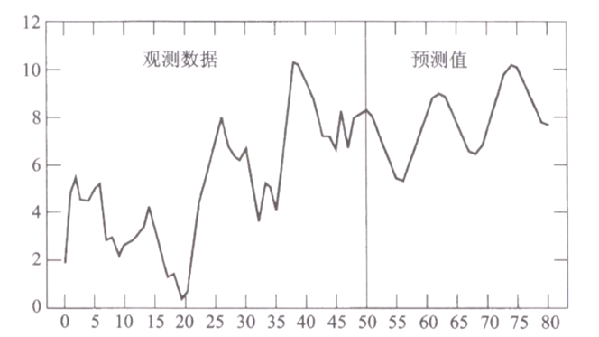
1.初识时间序列
什么是时间序列？
时间序列是指
将同一统计指标的数值
按其发生的时间先后顺序
排列而成的数列。
Notes:
时间序列引例

Slide 4
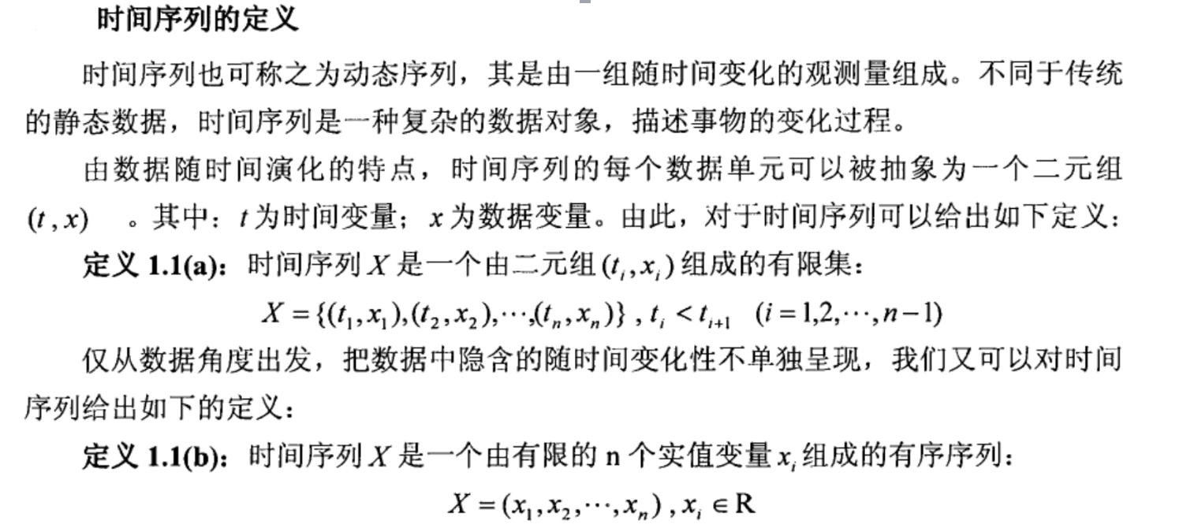
1.初识时间序列
Notes:
“时间序列”的定义

Slide 5
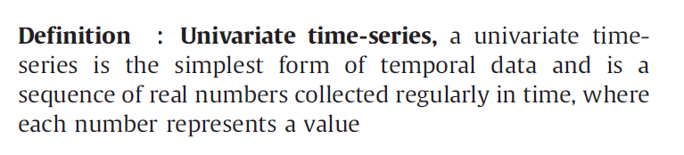
1.初识时间序列
A sequence composed of a series of nominal symbols from a
particular alphabet is usually called a temporal sequence, and
a sequence of continuous, real-valued elements, is known as a
time-series
Notes:
“单变量时间序列”的定义。（temporal sequence和time-series分别应该怎么翻译，怎么区别？）

Slide 6
1.初识时间序列
构成要素：长期趋势，季节变动，循环变动，不规则变动
长期趋势（ T ）现象在较长时期内受某种根本性因素作用而形成的总的变动趋势。
季节变动（ S ）现象在一年内随着季节的变化而发生的有规律的周期性变动。
循环变动（ C ）现象以若干年为周期所呈现出的波浪起伏形态的有规律的变动。
不规则变动（I ）是一种无规律可循的变动，包括严格的随机变动和不规则的突发性影响很大的变动两种类。
Notes:
时间序列的构成要素/特点

Slide 7
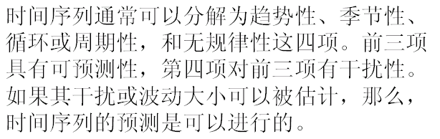
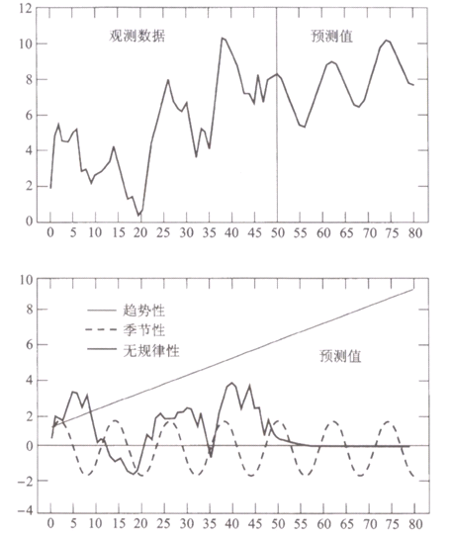
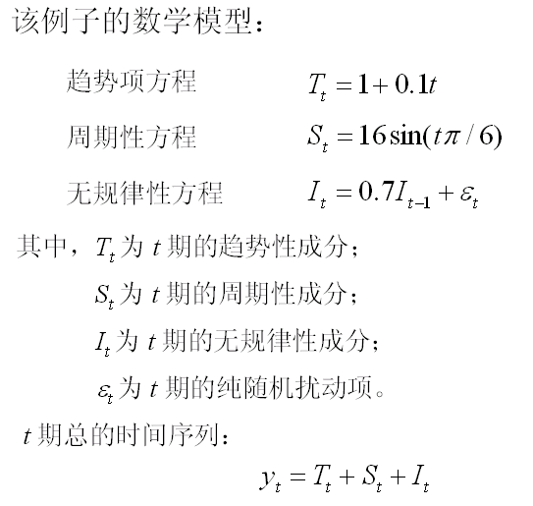
1.初识时间序列
Notes:
时间序列组成成分的拆分

Slide 8
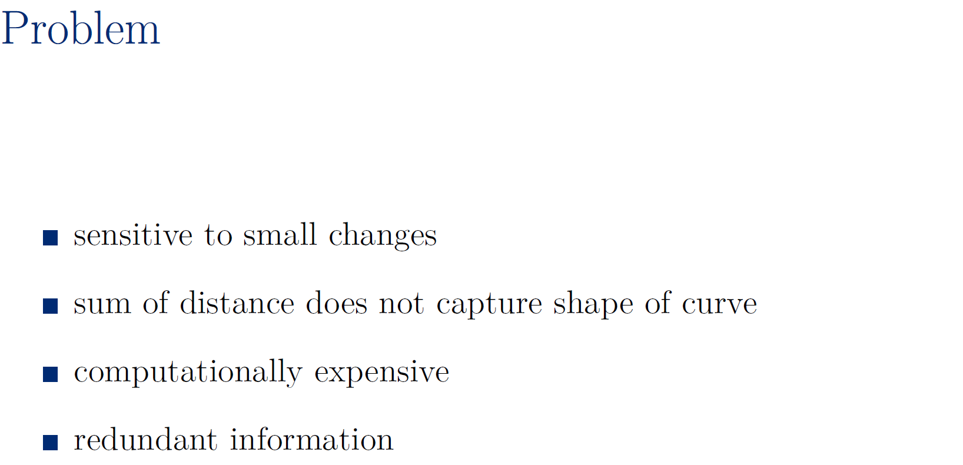
1.初识时间序列
Notes:
时间序列存在的一些问题

Slide 9
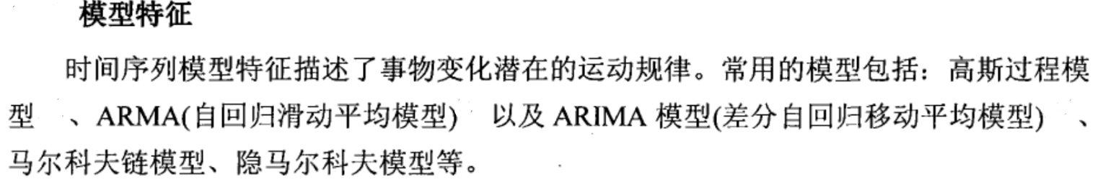
1.初识时间序列
下面简单介绍一种ARMA（自回归滑动平均模型）
Notes:
略过：时间序列的模型(和预处理方法），理解不到位

Slide 10
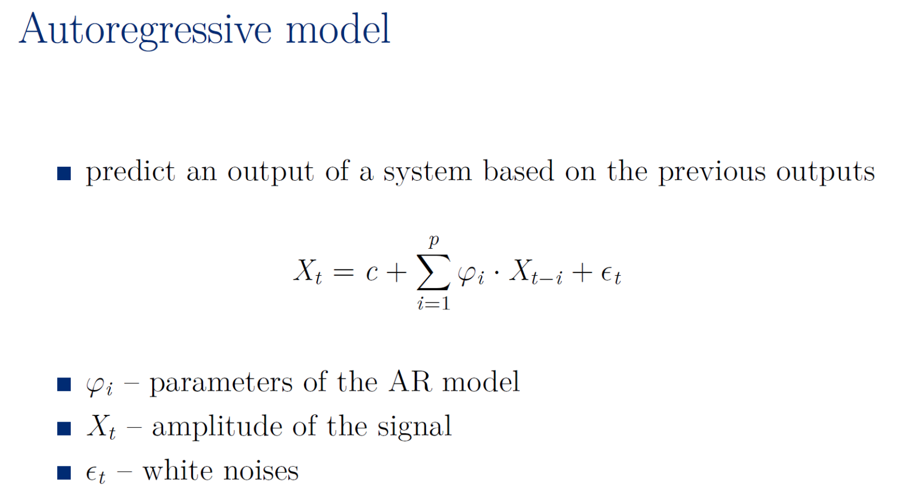
1.初识时间序列
Notes:
（自回归模型）AR模型举例

Slide 11
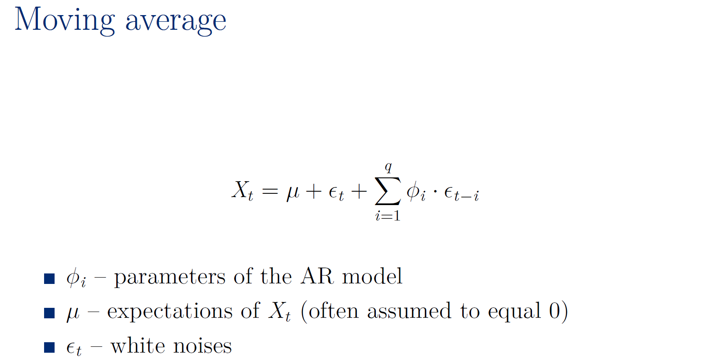
1.初识时间序列
Notes:
（移动平均模型/移动线性组合）MA模型举例

Slide 12
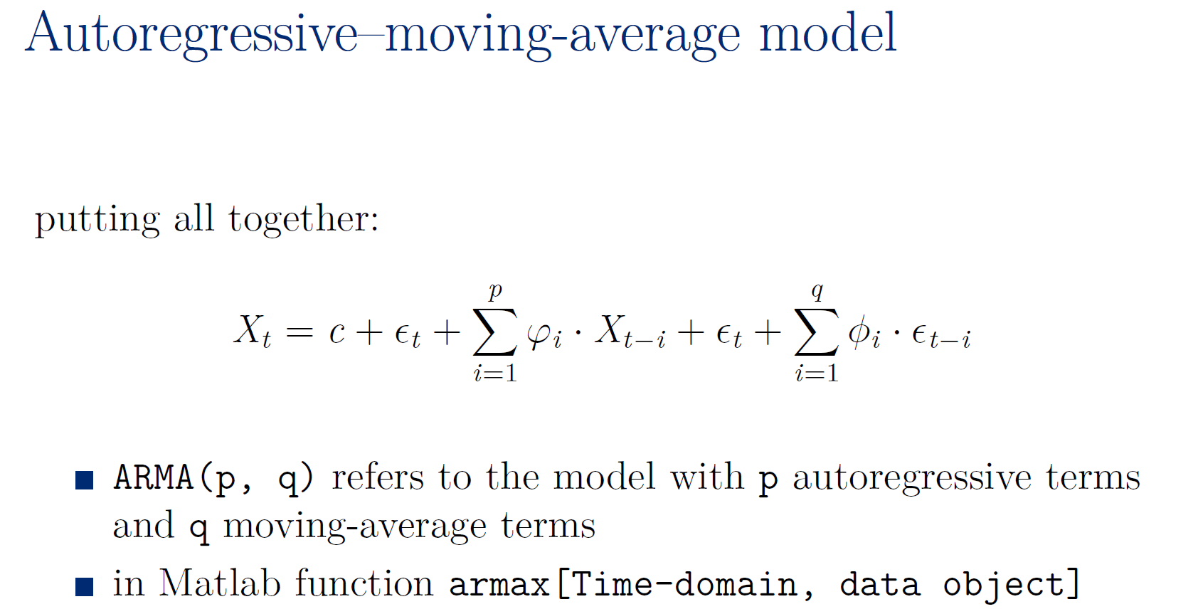
1.初识时间序列
Notes:
（自回归滑动平均）ARMA模型举例

Slide 13

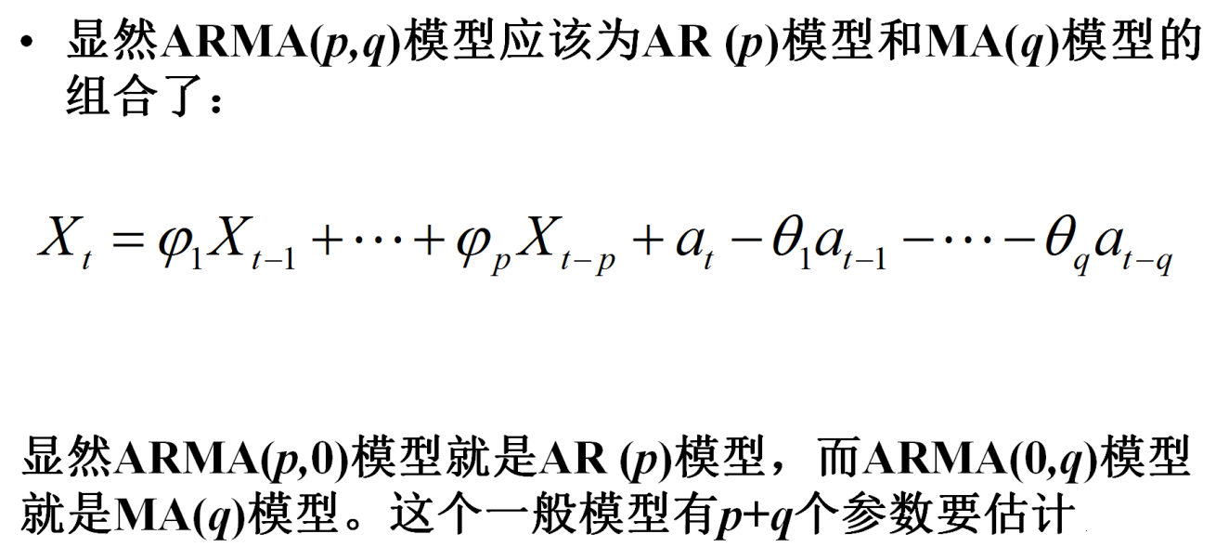
1.初识时间序列
Notes:
（自回归滑动平均）ARMA模型举例

Slide 14
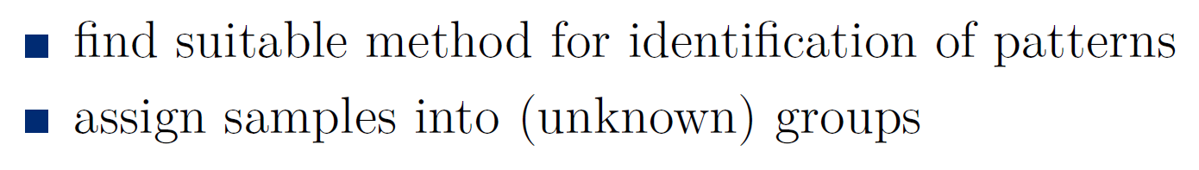
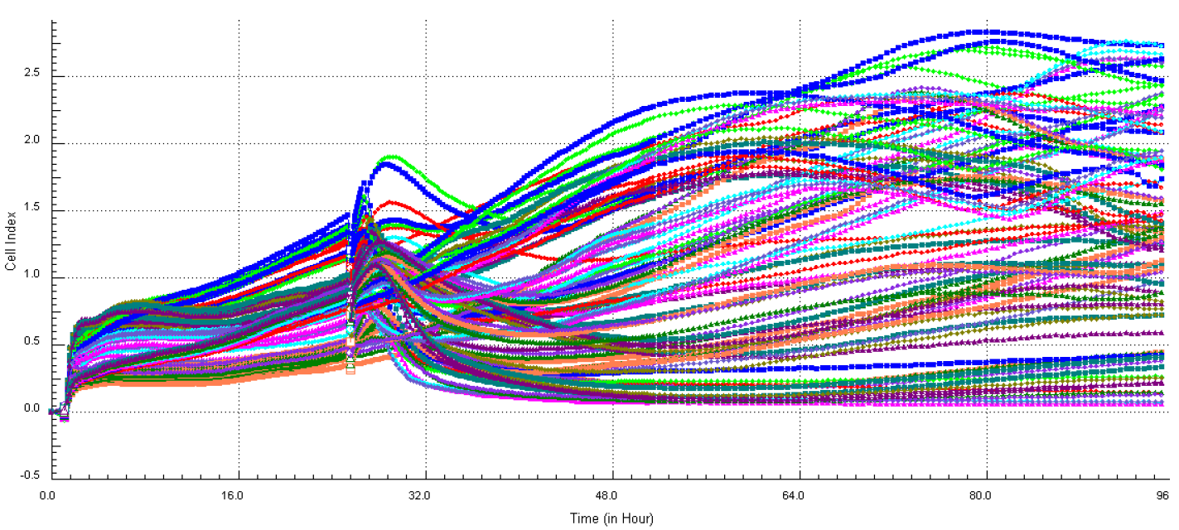
2.时间序列聚类问题概述
Notes:
时间序列聚类问题引例

Slide 15
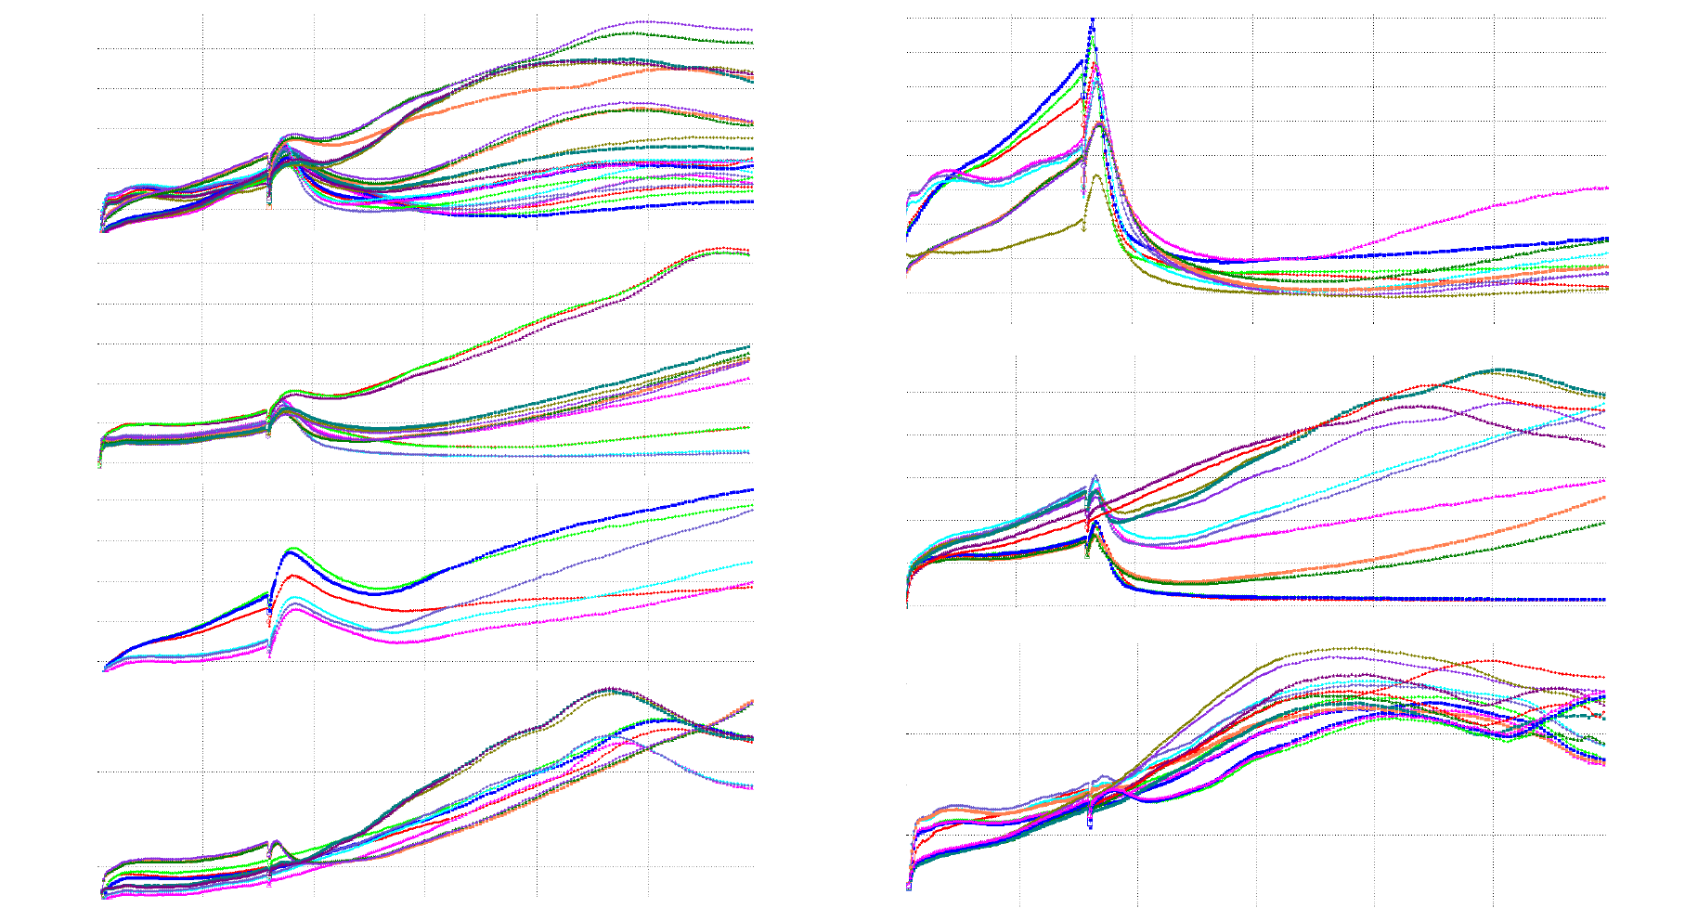
2.时间序列聚类问题概述
Notes:
时间序列聚类问题引例

Slide 16
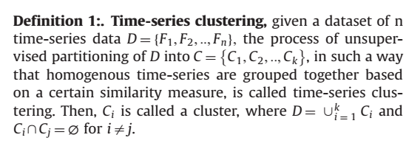
2.时间序列聚类问题概述
clusters are formed by grouping objects that
have maximum similarity with other objects within the group,
and minimum similarity with objects in other groups.
Notes:
“时间序列聚类”定义

Slide 17
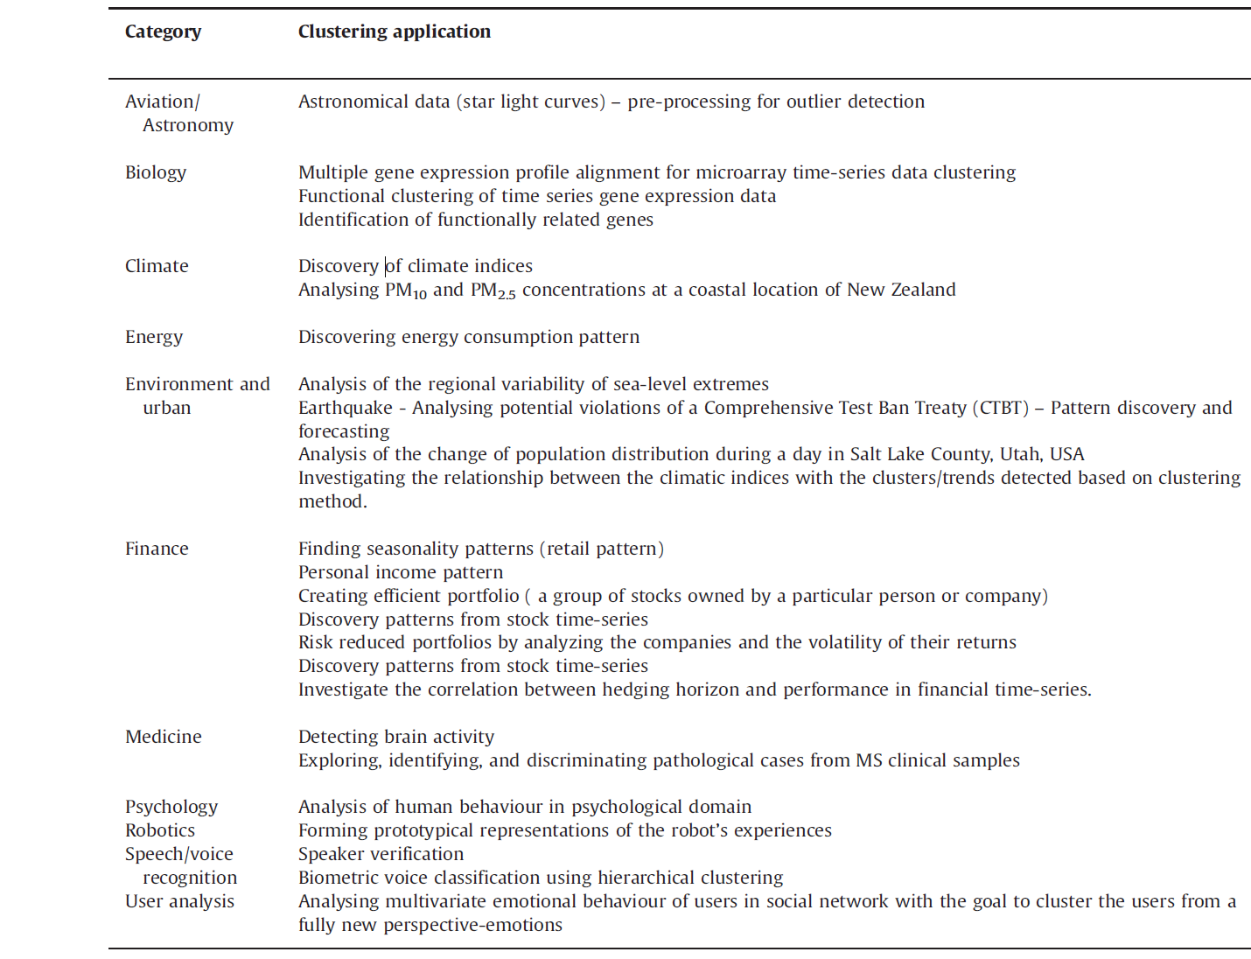
2.时间序列聚类问题概述
Samples of objectives of time-series clustering
in different domains. ---->
Recognizing dynamic changes in time-series
Prediction and recommendation
Pattern discovery
......
（总之就是用途广、很有用）
Notes:
略过：应用举例

Slide 18
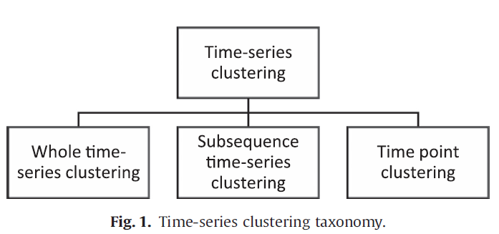
2.时间序列聚类问题概述
Notes:
三类时序聚类问题

Slide 19
2.时间序列聚类问题概述
Whole time-series clustering is considered as clustering
of a set of individual time-series with respect to their similarity.
Subsequence clustering means clustering on a set of
subsequences of a time-series that are extracted via a
sliding window, that is, clustering of segments from a
single long time-series.
Time point clustering is another category of clustering
which is seen in some papers. It is clustering of time points
based on a combination of their temporal proximity of time
points and the similarity of the corresponding values.
Notes:
三类时序聚类问题

Slide 20
2.时间序列聚类问题概述
Essentially, sub-sequence clustering is performed on a
single time-series, and Keogh and Lin represented that
this type of clustering is meaningless.
Time-point clustering also is applied on a single time-series,
and is similar to time series segmentation as the objective of
time-point clustering is finding the clusters of time-point
instead of clusters of time-series data.
The focus of this study is on the “whole time-series clustering”.
Notes:
只focous on the “whole time-series clustering”

Slide 21
2.时间序列聚类问题概述
Time-series clustering is a challenging issue because :
1. far larger : time-series data are often far larger than memory size
and consequently they are stored on disks. This leads to an
exponential decrease in speed of the clustering process.
2. high dimensional : time-series data are often high dimensional which makes handling these data difficult for many clustering algorithms and also slows down
the process of clustering.
3. similarity measures :Time-series clustering relies on distance measure to a high extent.
The process of “whole sequence matching” is complicated, because :
1. time-series data are naturally noisy and include outliers and shifts
2. the length of time-series varies and the distance among them needs to be calculated.
Notes:
时序聚类困难点

Slide 22
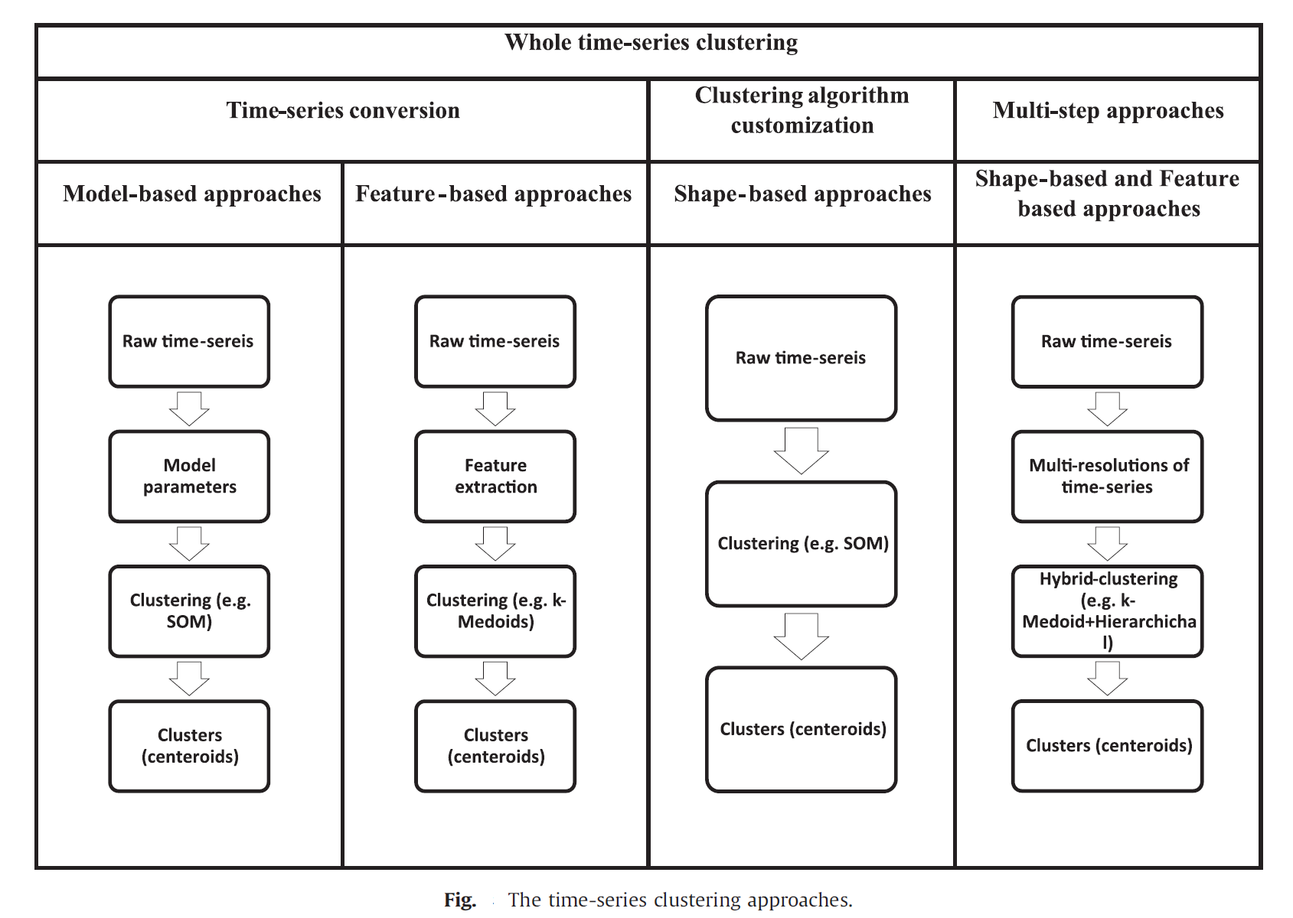
2.时间序列聚类问题概述
Notes:
时序聚类常见流程

Slide 23
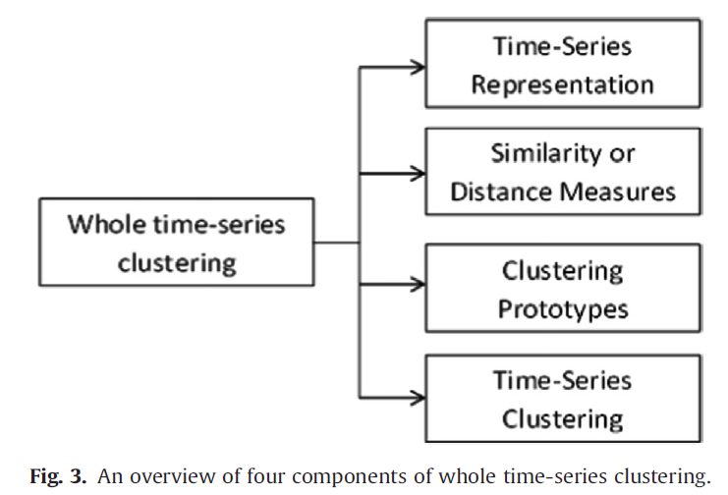
3.关于时间序列聚类的研究
关于时间序列聚类的研究可以分为五个方面、四个组成部分：
1. dimensionality reduction or representation method
2. distance measurement
3. clustering algorithm
4. prototype definition
5. evaluation.
Notes:
时序聚类的五个方面，四个组成部分

Slide 24
3.关于时间序列聚类的研究
Usually, data is approximated using a
representation method in such a way that
can fit in memory.
Afterwards,a clustering algorithm is
applied on data by using a distance measure.
In the clustering process, usually a prototype
is required for summarization of the time-series.
At last, the clusters are evaluated using criteria.
Notes:
时序聚类的流程

Slide 25
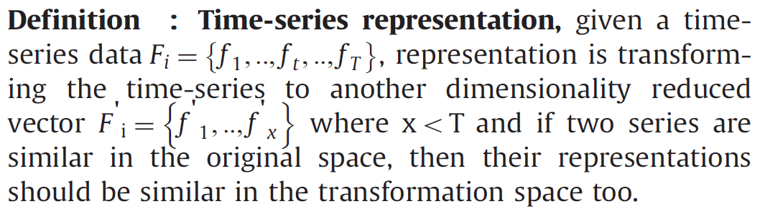
3.关于时间序列聚类的研究
1. Representation methods for time series clustering
Notes:
时序表示=>降维

Slide 26
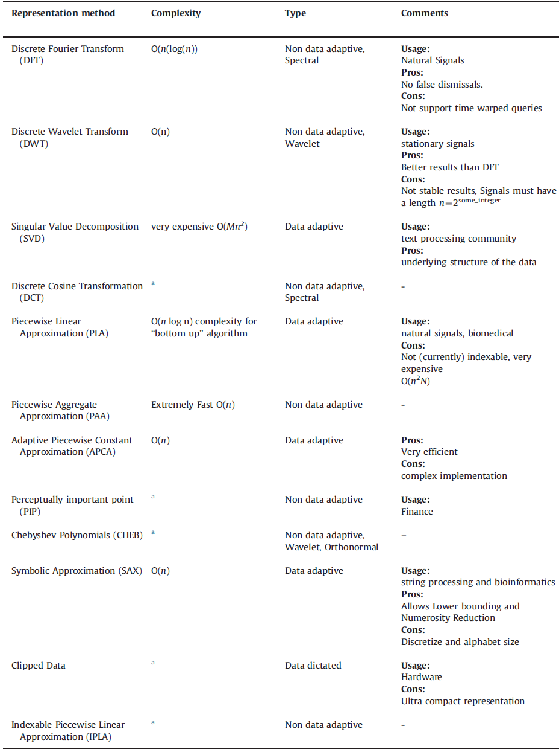
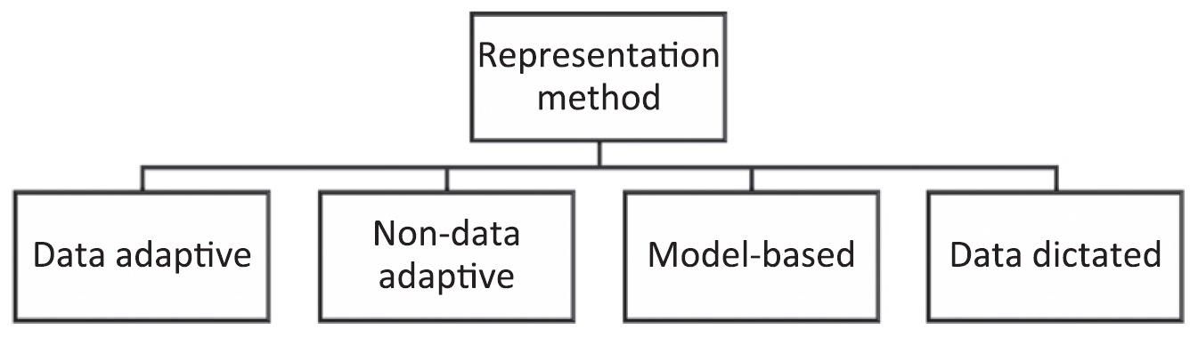
3.关于时间序列聚类的研究
Representation methods for time-series data.
Notes:
略过：时序表示=>降维的分类

Slide 27
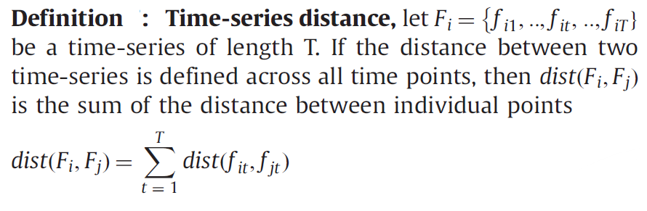
3.关于时间序列聚类的研究
2. Similarity/dissimilarity measures in time-series clustering
Notes:
时序距离的定义，常用欧氏距离和DTW

Slide 28
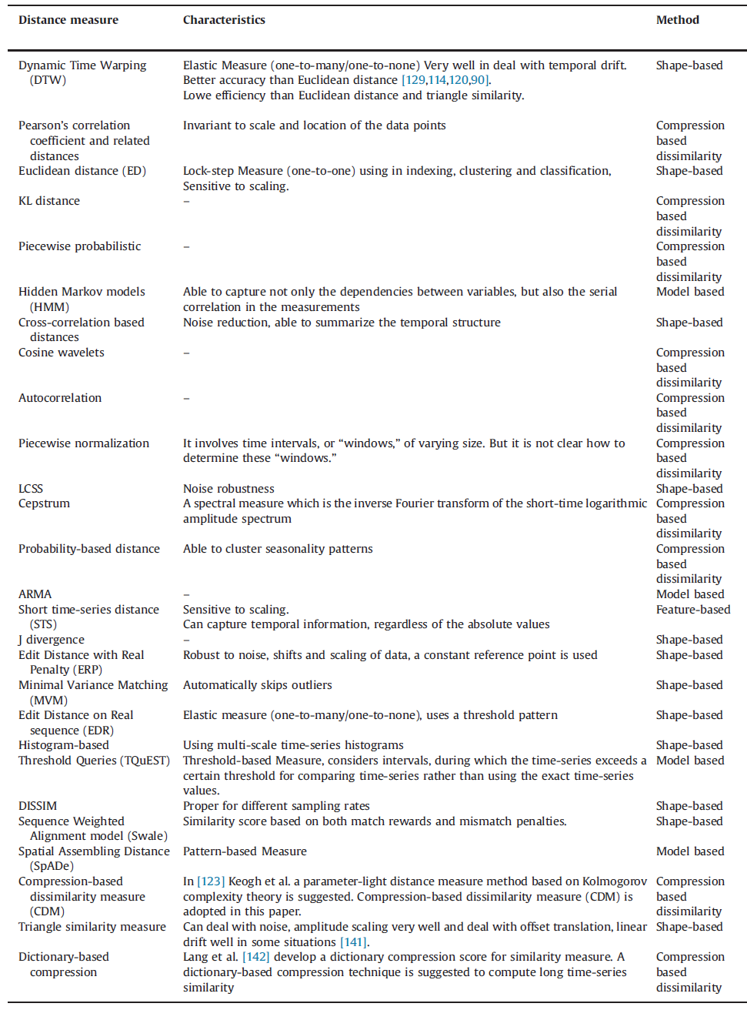
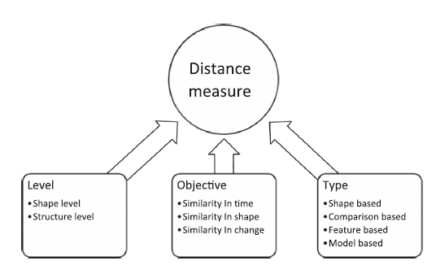
3.关于时间序列聚类的研究
Similarity measure approaches in the literature.
Notes:
略过：时序距离的例子，不是很理解

Slide 29
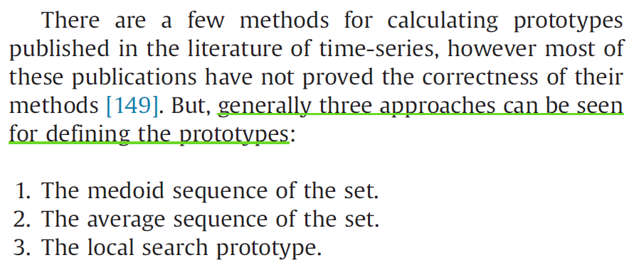
3.关于时间序列聚类的研究
3. Time-series cluster prototypes
Notes:
略过:聚类原型,不太懂

Slide 30
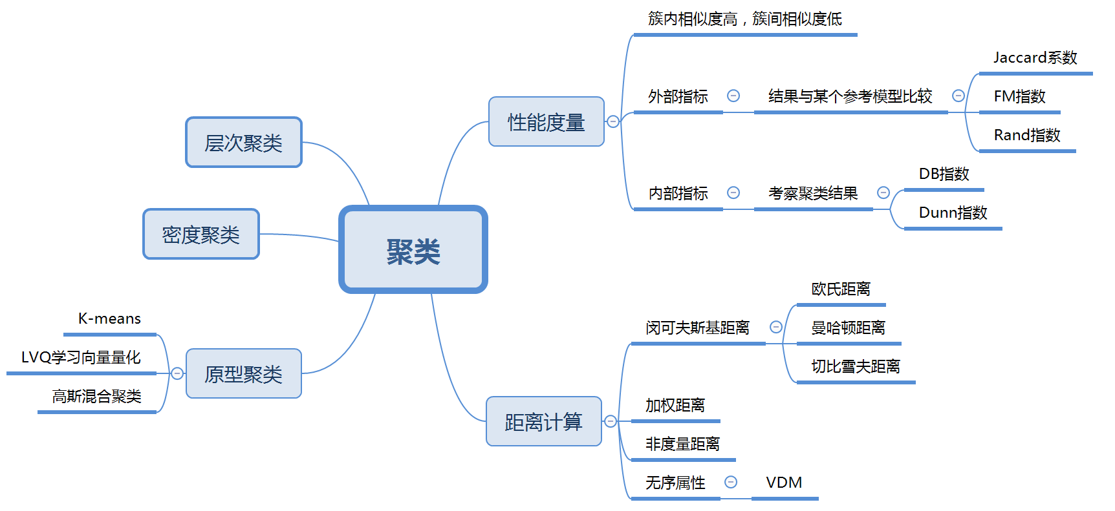
3.关于时间序列聚类的研究
Notes:
聚类回顾

Slide 31
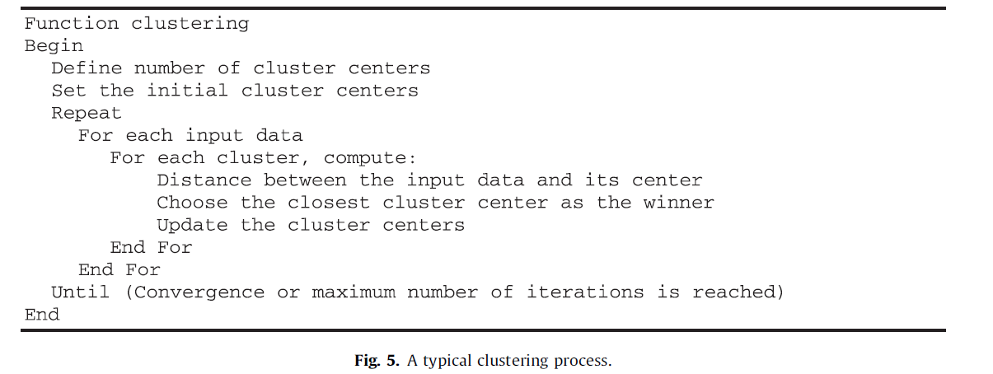
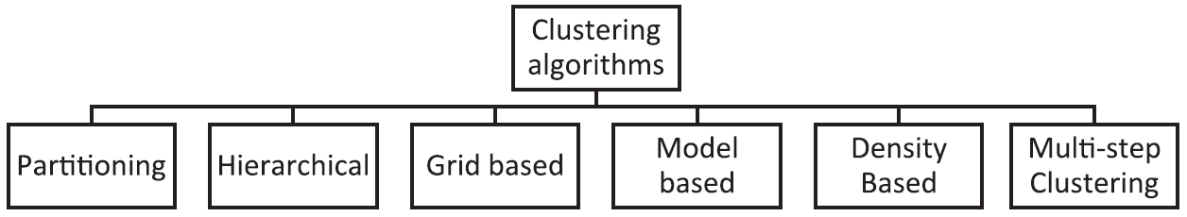
3.关于时间序列聚类的研究
4. Time-series clustering algorithms
Notes:
略过：时序聚类算法概述，具体算法还没有研究

Slide 32
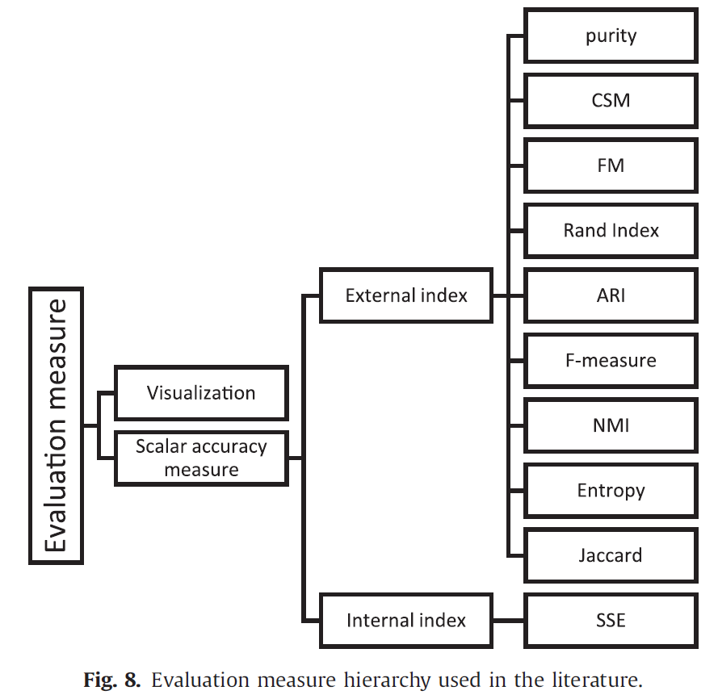
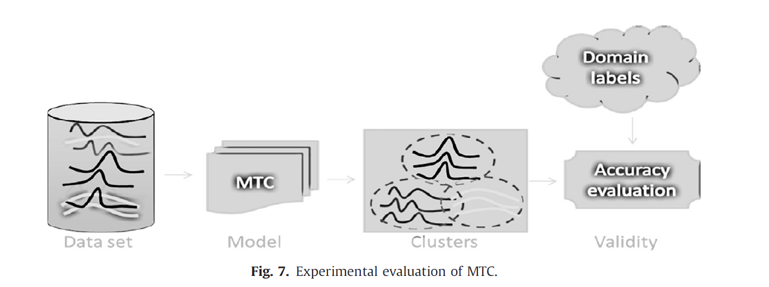
3.关于时间序列聚类的研究
5. Time-series clustering evaluation measures
Notes:
略过：评估方法 （图中的index应该如何翻译和理解？）

Slide 33
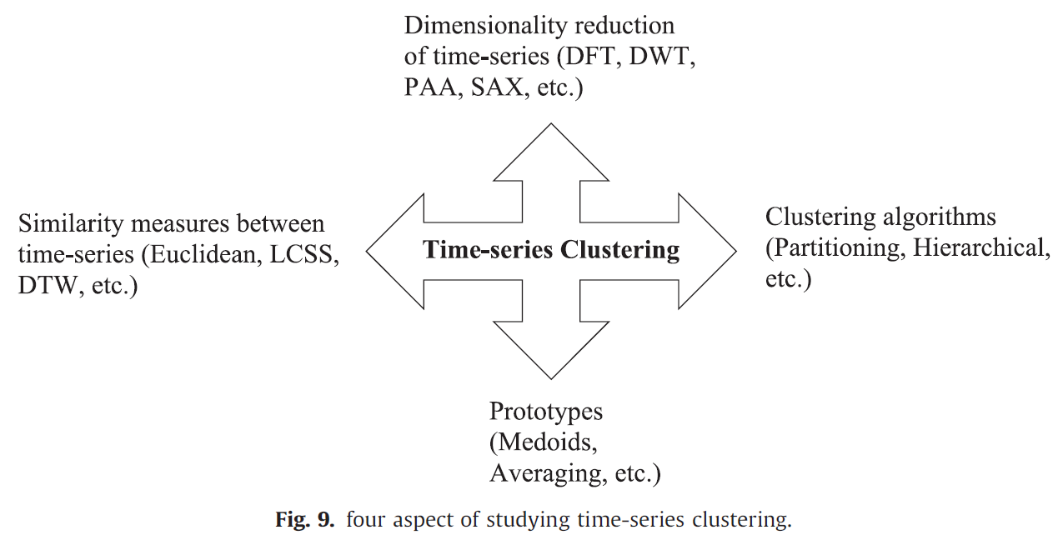
3.关于时间序列聚类的研究
Notes:
时序聚类的四个研究方向/四个组成部分

Slide 34
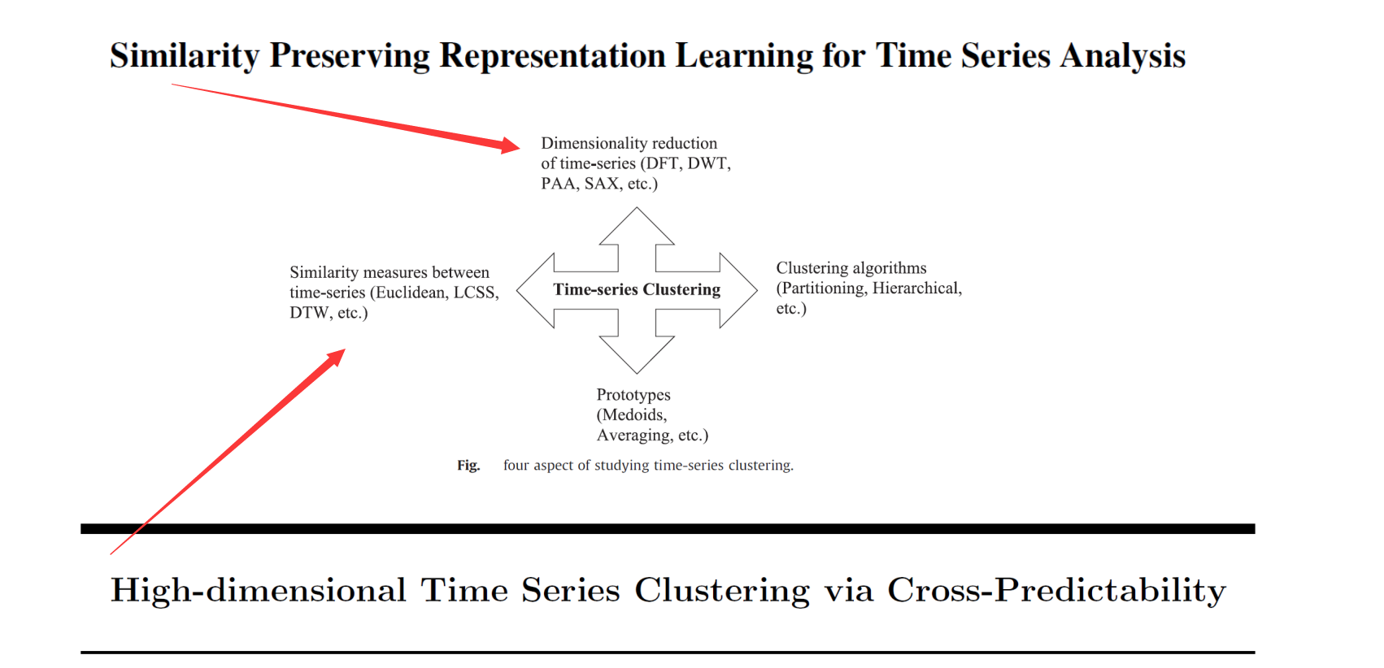
3.关于时间序列聚类的研究
Notes:
另外的两篇论文与四个研究方向的关系

Slide 35
最后回顾
1.初识时间序列
（时间序列的定义、单变量时间序列、ARMA模型、四种性质）
2.时间序列聚类问题概述
（时序聚类的定义、应用、类别、难点分析、大致流程）
3.关于时间序列聚类的研究
（时序表示、距离度量、聚类原型、聚类方法，以及评估方法）
Notes:
回顾

Slide 36
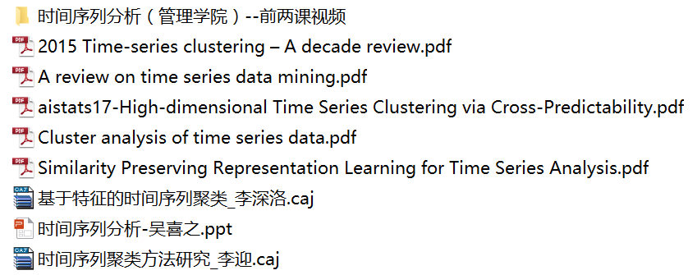
参考资料
Notes:
参考资料

Slide 37
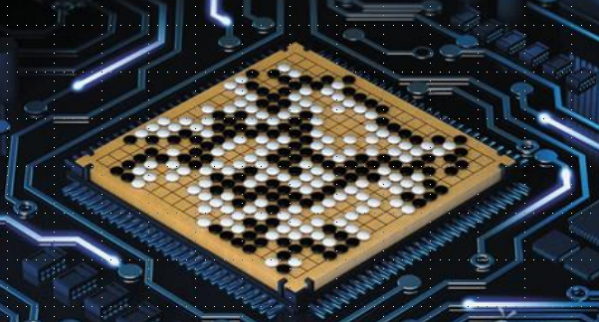
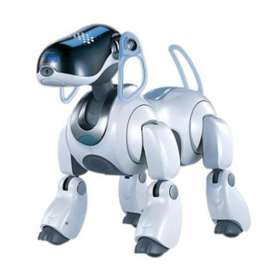
Thanks for your listening ...

